Slide 1

Rio de Janeiro 2016
Prepared:
Zhuldyz Sultan
Balerke Khidirova
Examinator: Zhangir Rayev
Examinator: Zhangir Rayev

Slide 2


Libraries
The csv module implements classes to read and write tabular data in CSV format
pandas is a software library, In particular, it offers data structures and operations for manipulating numerical tables and time series. We used this library to read csv files
The name Tkinter comes from Tk interface.We use to:
Imported the Tkinter module.
Created the main application window.
Added the widgets like labels, buttons, frames, etc. to the window.
Called the main event loop so that the actions can take place on the user's computer screen.

Slide 3
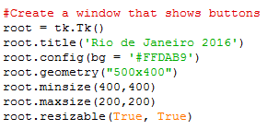
Widgets can be configured at creation time, but sometimes it is necessary to change the configuration of a widget at runtime. To do this, use the configure method (or its synonym config).
geometry--This method is used to set the dimensions of the Tkinter window and is used to set the position of the main window on the user’s desktop
With the help of the title we will name the window
The determines the minimum and maximum size of the shape
resizable() method is used to allow Tkinter root window to change it's size according to the users need as well we can prohibit resizing of the Tkinter window. So, basically, if user wants to create a fixed size window, this method can be used.

Slide 4
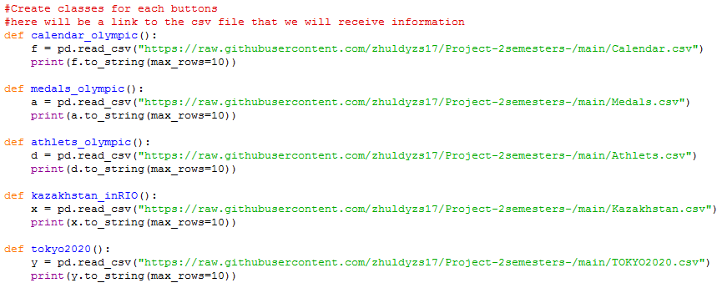
print(f.to_string(max_rows=10)) – this is a function in order show us the maximum number of columns that we need
Created classes with library pandas for reading csv files for each button.

Slide 5
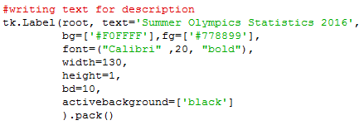
activebackground The background color that will appear on a choice when it is under the mouse
bg
The background color for choices not under the mouse.
*font
*The default font for textual choices.
fg
The foreground color used for choices not under the mouse.
*bd
*The width of the border around all the choices. Default is 1.

Slide 6
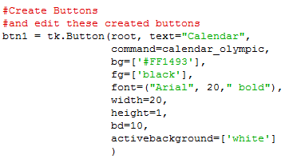
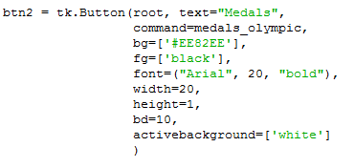
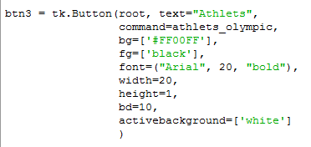
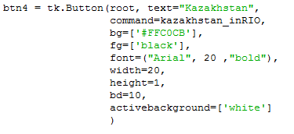
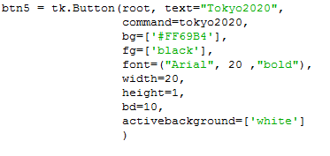
Creat buttons for the window

Slide 7
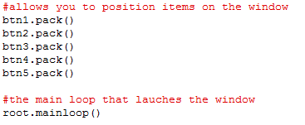
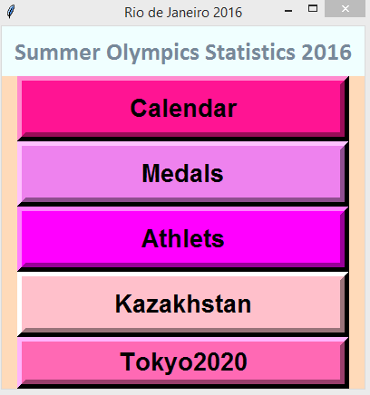
Here is our created window and buttons
Python - Tkinter pack() Method - This geometry manager organizes widgets in blocks before placing them in the parent widget.
mainloop() tells Python to run the Tkinter event loop. This method listens for events, such as button clicks or keypresses, and blocks any code that comes after it from running until the window it's called on is closed. Go ahead and close the window you've created, and you'll see a new prompt displayed in the shell.

